Slide 1
作业
1、你对人工智能定义的理解？
2、解释什么是图灵测试？
3、简述人工智能的三大学派及其研究方法。

Slide 2
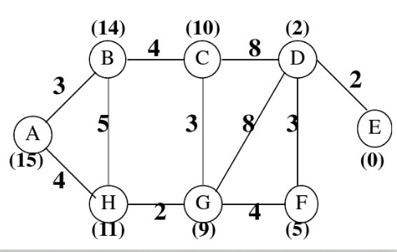
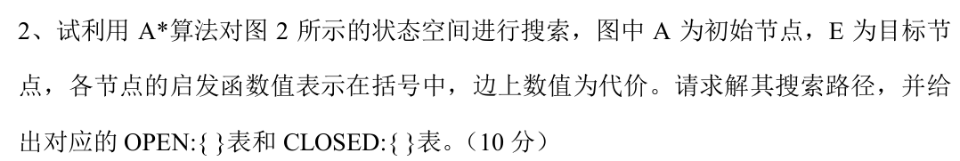
1.用5种搜索方法DFS、BFS、UCS、Greedy、A*分别求解从A到E的搜索路径(访问过的节点不再访问)

Slide 3
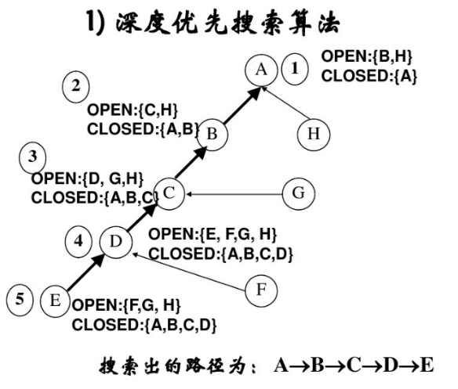

Slide 4
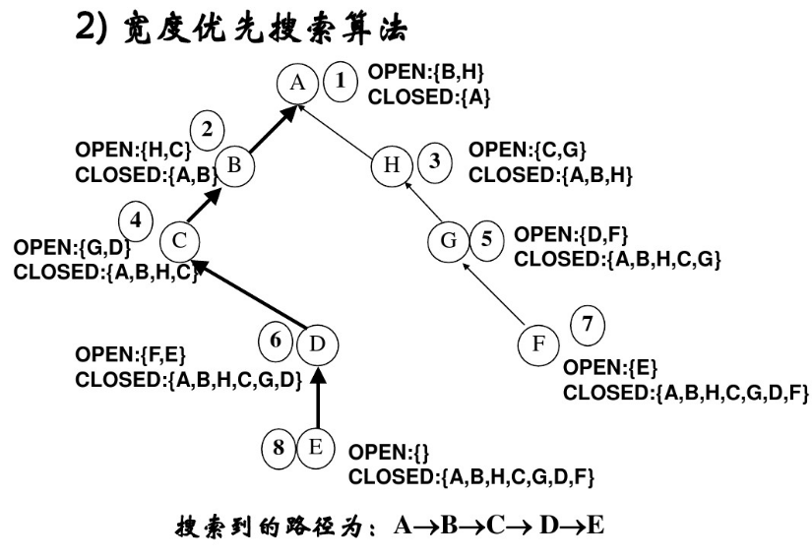

Slide 5
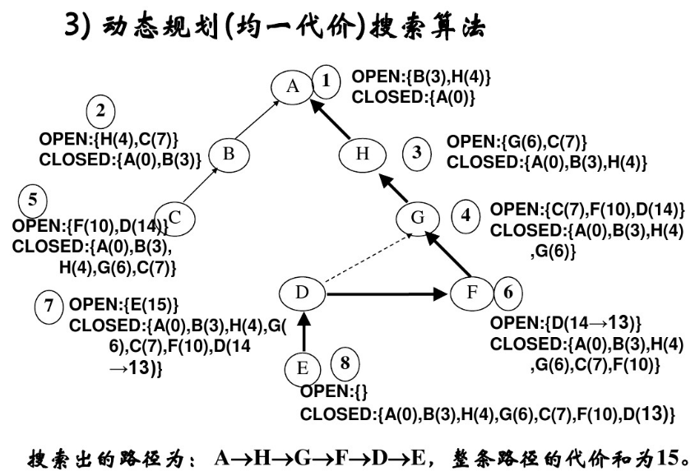

Slide 6
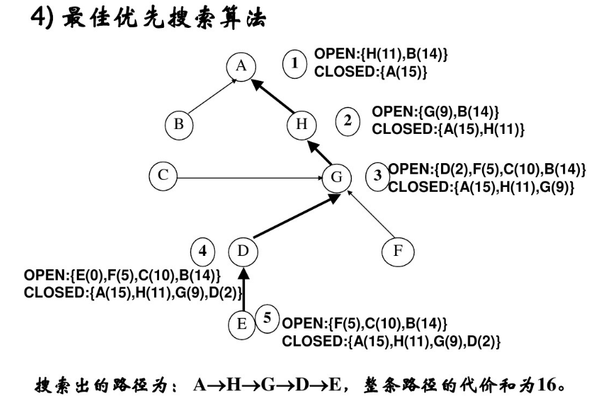

Slide 7
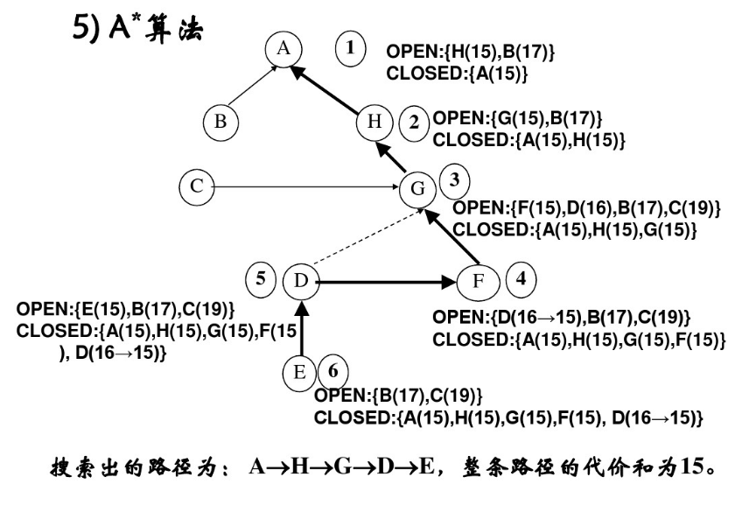

Slide 8
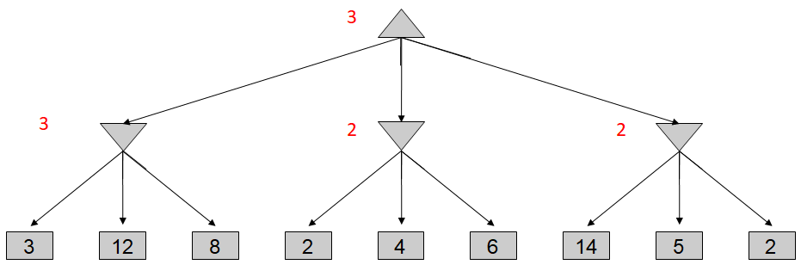
α-β剪枝
剪枝方法
(1) MAX节点（或节点）的α值为当前子节点的最大倒推值；
α=到目前为止路径上发现的MAX的最佳（极大值）选择
(2) MIN节点（与节点）的β值为当前子节点的最小倒推值；
β=到目前为止路径上发现的MIN的最佳（极小值）选择
(3) α-β剪枝的规则如下：
α剪枝
任何MAX节点n的α值大于或等于它先辈节点的β值，则n 以下的分枝可停止搜索，并令节点n的倒推值为α。这种剪枝称为α剪枝。
β剪枝
任何MIN节点n的β值小于或等于它先辈节点的α值，则n 以下的分枝可停止搜索，并令节点n的倒推值为β。这种剪枝称为β剪枝。
MAX
MIN
m
MAX
MIN
n

Slide 9
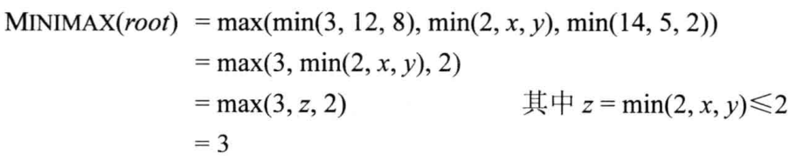
α-β剪枝
3
3
≤2
2
3
12
8
2
14
5
2

Slide 10

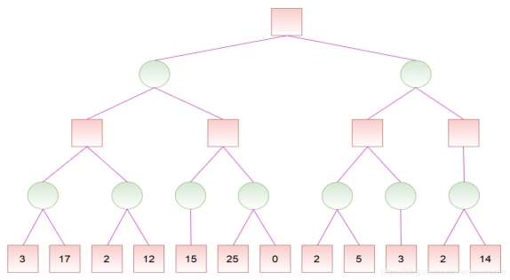
2. 请用α-β剪枝算法进行剪枝，给出根节点的数值
3
3
3
3
3
15
3
3
2
15
2
3

Slide 11
作业：用归结演绎推理的方法证明下列问题
1、“快乐学生”问题
假设：任何通过计算机考试并获奖的人都是快乐的，任何肯学习或幸运的人都可以通过所有考试，张不肯学习但他是幸运的，任何幸运的人都能获奖。
求证：张是快乐的。
2、“激动人心的生活”问题
假设：所有不贫穷并且聪明的人都是快乐的，那些看书的人是聪明的。李明能看书且不贫穷，快乐的人过着激动人心的生活。
求证：李明过着激动人心的生活。

Slide 12
归结演绎推理的经典例子
例 “快乐学生”问题
假设：任何通过计算机考试并获奖的人都是快乐的，任何肯学习或幸运的人都可以通过所有考试，张不肯学习但他是幸运的，任何幸运的人都能获奖。
求证：张是快乐的。
解：先定义谓词：
Pass(x, y) x可以通过y考试
Win(x, prize) x能获得奖励
Study(x) x肯学习
Happy(x) x是快乐的
Lucky(x) x是幸运的

Slide 13
归结演绎推理的经典例子
再将问题用谓词表示如下：
“ 任何通过计算机考试并获奖的人都是快乐的”
(∀x)(Pass(x, computer)∧Win(x, prize)→Happy(x))
“ 任何肯学习或幸运的人都可以通过所有考试”
(∀x) (∀y) (Study(x)∨Lucky(x)→Pass(x, y))
“ 张不肯学习但他是幸运的”
﹁Study(zhang)∧Lucky(zhang)
“ 任何幸运的人都能获奖”
(∀x) (Lucky(x)→Win(x, prize))
结论“ 张是快乐的”的否定
﹁Happy(zhang)

Slide 14
归结演绎推理的经典例子
将上述谓词公式转化为子句集如下：
(1) ﹁Pass(x, computer)∨﹁Win(x, prize)∨Happy(x)
(2) ﹁Study(y)∨Pass(y, z)
(3) ﹁Lucky(u)∨Pass(u, v)
(4) ﹁Study(zhang)
(5) Lucky(zhang)
(6) ﹁Lucky(w)∨Win(w, prize)
(7) ﹁Happy(zhang) (结论的否定)

Slide 15
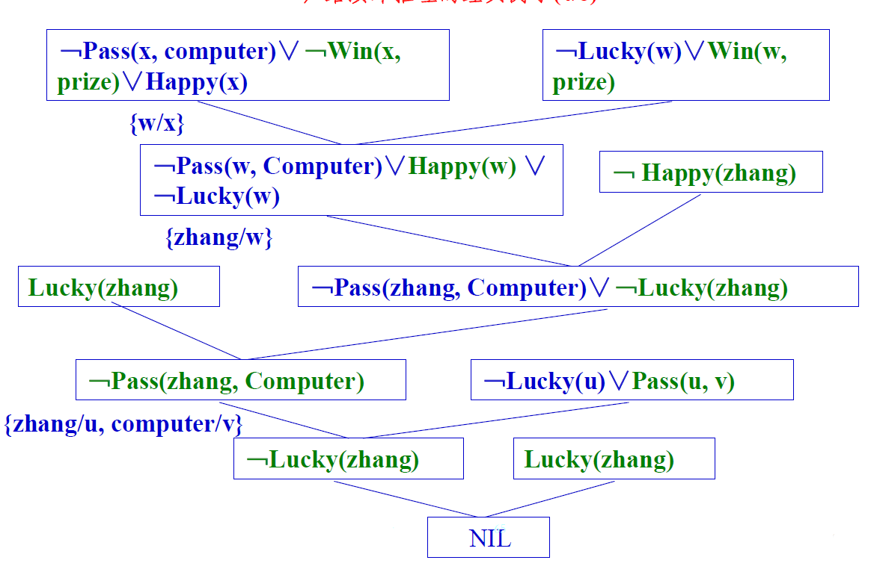
归结演绎推理的经典例子

Slide 16
归结演绎推理的经典例子
例 “激动人心的生活”问题
假设：所有不贫穷并且聪明的人都是快乐的，那些看书的人是聪明的。李明能看书且不贫穷，快乐的人过着激动人心的生活。
求证：李明过着激动人心的生活。
解：先定义谓词：
Poor(x) x是贫穷的
Smart(x) x是聪明的
Happy(x) x是快乐的
Read(x) x能看书
Exciting(x) x过着激动人心的生活

Slide 17
归结演绎推理的经典例子
再将问题用谓词表示如下：
“ 所有不贫穷并且聪明的人都是快乐的”
(∀x)((﹁Poor(x)∧Smart(x))→Happy(x))
“ 那些看书的人是聪明的”
(∀y) (Read(y) →Smart(y))
“ 李明能看书且不贫穷”
Read(Liming)∧﹁Poor(Liming)
“ 快乐的人过着激动人心的生活”
(∀z) (Happy(z)→Exciting(z))
目标“ 李明过着激动人心的生活”的否定
﹁Exciting(Liming)

Slide 18
归结演绎推理的经典例子
将上述谓词公式转化为子句集如下：
(1) Poor(x)∨﹁Smart(x)∨Happy(x)
(2) ﹁Read(y)∨Smart(y)
(3) Read(Liming)
(4) ﹁Poor(Liming)
(5) ﹁Happy(z)∨Exciting(z)
(6) ﹁Exciting(Liming) (结论的否定)

Slide 19
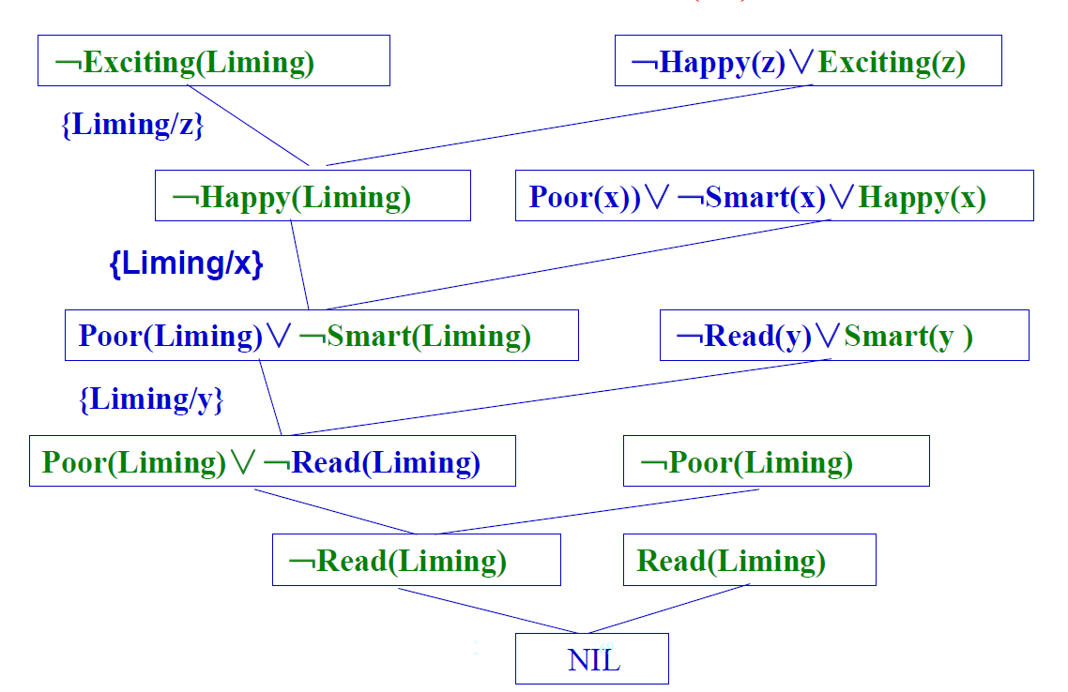
归结演绎推理的经典例子

Slide 20
3.3.2置换与合一
置换可简单的理解为是在一个谓词公式中用置换项去替换变量。
定义7 置换是形如
{t1 /x1 ,t2 /x2 ,…,tn /xn }
的有限集合。其中，t1 ,t2 ,…,tn 是项；x1 ,x2 ,…,xn 是互不相同的变元；ti /xi 表示用ti 替换xi 。要求：ti 与xi 不能相同，xi 不能循环地出现在另一个ti 中。
例如，{a/x, c/y, f(b)/z} 是一个置换。
但 {g(z)/x, f(x)/z}不是一个置换。
原因是它在x与z之间出现了循环置换现象。即当用g(z)置换x,用f(g(z))置换z时，既没有消去x，也没有消去z。
若改为{g(a)/x, f(x)/z}即可，原因是用g(a)置换x ，用f(g(a))置换z ，则消去了x和z。
通常，置换是用希腊字母θ、σ、α、λ等来表示的。

Slide 21
3.3.2置换与合一
合一
可理解为是寻找相对变量的置换，使两个或多个谓词公式一致。
定义9 设有公式集F={F1 , F2 ,…,Fn }，若存在一个置换θ，可使
F1θ=F2θ=…=Fnθ，
则称θ是F的一个合一。称F1 ,F2 ,…,Fn是可合一的。
例如，设有公式集F={P(x, y, f(y)), P(a, g(x), z)}，则
λ={a/x, g(a)/y, f(g(a))/z}
是它的一个合一。
一般情况下,一个公式集的合一不是惟一的。

Slide 22





Markov Decision Processes
An MDP is defined by:
A set of states s ∈ S
A set of actions a ∈ A
A transition function T(s, a, s’)
Probability that a from s leads to s’, i.e., P(s’| s, a)
Also called the model or the dynamics
A reward function R(s, a, s’)
Sometimes just R(s) or R(s’)
A start state
Maybe a terminal state
MDPs are non-deterministic search problems
One way to solve them is with expectimax search
We’ll have a new tool soon
[Demo – gridworld manual intro (L8D1)]
Notes:
In search problems: did not talk about actions, but about successor functions --- now the information inside the successor function is unpacked into actions, transitions and reward
Write out S, A, example entry in T, entry in R
Reward function different from the book : R(s,a,s’)
In book simpler for equations, but not useful for the projects.
Need to modify expectimax a tiny little bit to account for rewards along the way, but that’s something you should be able to do, and so you can already solve MDP’s (not in most efficient way)

Slide 23

What is Markov about MDPs?
“Markov” generally means that given the present state, the future and the past are independent
For Markov decision processes, “Markov” means action outcomes depend only on the current state
This is just like search, where the successor function could only depend on the current state (not the history)
Andrey Markov (1856-1922)
Notes:
Like search: successor function only depended on current state
Can make this happen by stuffing more into the state;
Very similar to search problems: when solving a maze with food pellets, we stored which food pellets were eaten

Slide 24
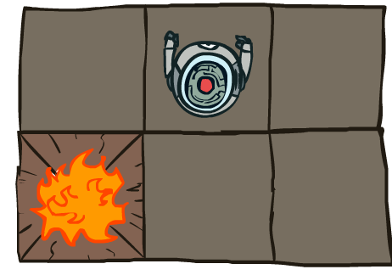


MDP Search Trees
Each MDP state projects an expectimax-like search tree
s
s is a state
a
(s, a) is a q-state
s, a
(s,a,s’) called a transition
T(s,a,s’) = P(s’|s,a)
R(s,a,s’)
s,a,s’
s’
Notes:
In MDP chance node represents uncertainty about what might happen based on (s,a) [as opposed to being a random adversary]
Q-state (s,a) is when you were in a state and took an action

Slide 25




Discounting(折扣)
It’s reasonable to maximize the sum of rewards
It’s also reasonable to prefer rewards now to rewards later
One solution: values of rewards decay exponentially（指数衰减）
Worth Now
Worth Next Step
Worth In Two Steps
Notes:
Inflation; really there is (1-gamma) prob of dying

Slide 26

Discounting
How to discount?
Each time we descend a level, we multiply in the discount once
Why discount?
Sooner rewards probably do have higher utility than later rewards
Also helps our algorithms converge
Example: discount of 0.5
U([1,2,3]) = 1*1 + 0.5*2 + 0.25*3
U([1,2,3]) < U([3,2,1])
Notes:
Rewards in the future (deeper in the tree) matter less
Interesting: running expectimax, if having to truncate the search, then not losing much; e.g., less then \gamma^d / (1-\gamma)
Augment q states with another option: instant death!

Slide 27
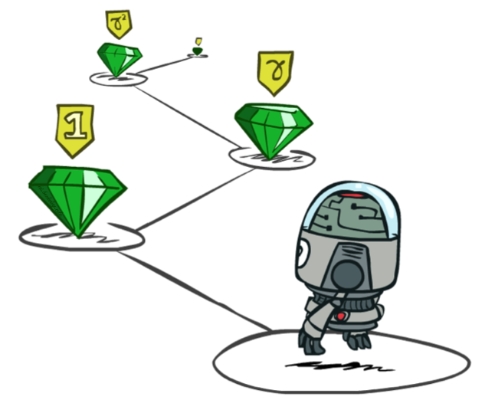
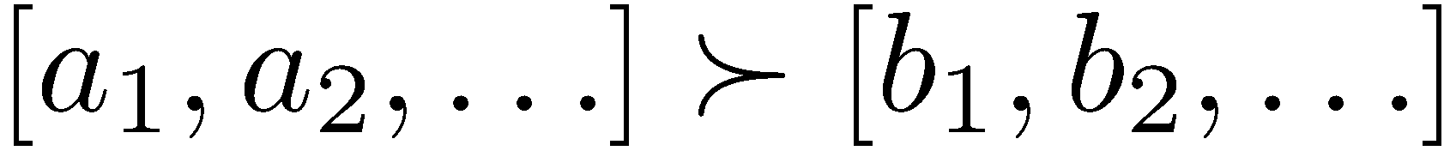
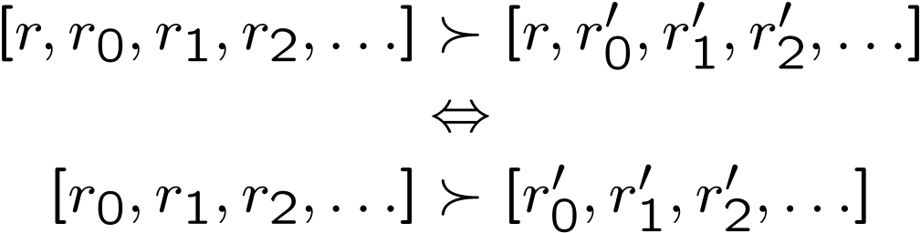
Stationary Preferences
Theorem: if we assume stationary preferences:
Then: there are only two ways to define utilities (proof: out of scope)
Additive utility
（累加回报）:
Discounted utility:
（折扣回报）
Notes:
板书

Slide 28

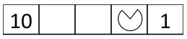
Quiz: Discounting
Given:
Actions: East, West, and Exit (only available in exit states a, e)
Transitions: deterministic
Quiz 1: For γ = 1, what is the optimal policy?
Quiz 2: For γ = 0.1, what is the optimal policy?
Quiz 3: For which γ are West and East equally good when in state d?

Slide 29
Optimal Quantities
The value (utility) of a state s:
V*(s) = expected utility starting in s and acting optimally
从s开始最佳行动的期望效用
The value (utility) of a q-state (s,a):
Q*(s,a) = expected utility starting out having taken action a from state s and (thereafter) acting optimally
从状态s开始采取行动a并（此后）以最佳方式行动的期望效用
The optimal policy:
π*(s) = optimal action from state s
从状态s开始的最优行动
s
s is a state
a
(s, a) is a q-state
s, a
s,a,s’
(s,a,s’) is a transition
s’
[Demo – gridworld values (L8D4)]
Notes:
[Note: this demo doesn’t show anything in action, just pops up V and Q values.]

Slide 30


Values of States
Fundamental operation: compute the (expectimax) value of a state
Expected utility under optimal action
Average sum of (discounted) rewards
This is just what expectimax computed!
Recursive definition of value:
s
a
s, a
s,a,s’
s’
These are the Bellman equations,
and they characterize optimal values in a way we’ll use over and over

Slide 31

Temporal Difference Learning(时序差分)

Slide 32
Temporal Difference Learning
Big idea: learn from every experience!
Update V(s) each time we experience a transition (s, a, s’, r)
Likely outcomes s’ will contribute updates more often
Temporal difference learning of values
Policy still fixed, still doing evaluation!
Move values toward value of whatever successor occurs: running average
s
π(s)
s, π(s)
s’
Sample of V(s):
Update to V(s):
时序差分：
相继状态之间的效用差分。
Same update:
思想：将效用估计朝着理想均衡方向调整。
Notes:
α是学习率

Slide 33
Example: Temporal Difference Learning
States
Observed Transitions
B, east, C, -2
C, east, D, -2
 | A
B | C | D
 | E
 | 0
0 | 0 | 8
 | 0
 | 0
-1 | 0 | 8
 | 0
 | 0
-1 | 3 | 8
 | 0
Assume: γ = 1, α = 1/2
Notes:
V(B)=(1-α)*V(B)+α*(r+γ*V(C)) =(1-1/2)*0+1/2*(-2+1*0) =-1 V(C)=(1-α)*V(C)+α*(r+γ*V(D)) =(1-1/2)*0+1/2*(-2+1*8) =3

Slide 34
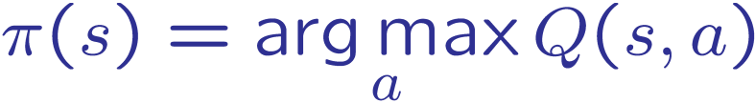
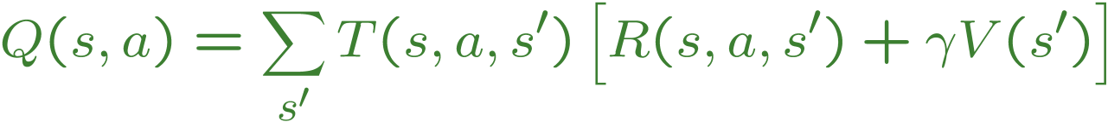
Problems with TD Value Learning
TD value leaning is a model-free way to do policy evaluation, mimicking Bellman updates with running sample averages
However, if we want to turn values into a (new) policy, we’re sunk:
Idea: learn Q-values, not values
Makes action selection model-free too!
s
a
s, a
s,a,s’
s’

Slide 35
Detour: Q-Value Iteration
Value iteration: find successive (depth-limited) values
Start with V₀(s) = 0, which we know is right
Given V_{k}, calculate the depth k+1 values for all states:
But Q-values are more useful, so compute them instead
Start with Q₀(s,a) = 0, which we know is right
Given Q_{k}, calculate the depth k+1 q-values for all q-states:

Slide 36
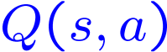
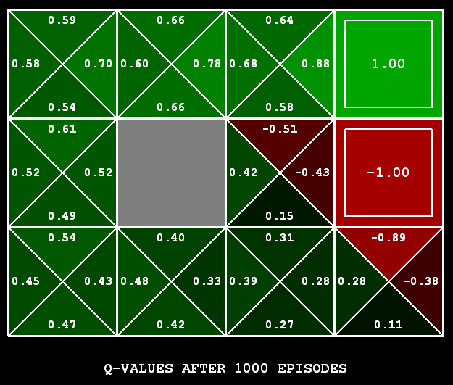
Q-Learning
Q-Learning: sample-based Q-value iteration
Learn Q(s,a) values as you go
Receive a sample (s,a,s’,r)
Consider your old estimate:
Consider your new sample estimate:
Incorporate the new estimate into a running average:
no longer policy evaluation!

Slide 37
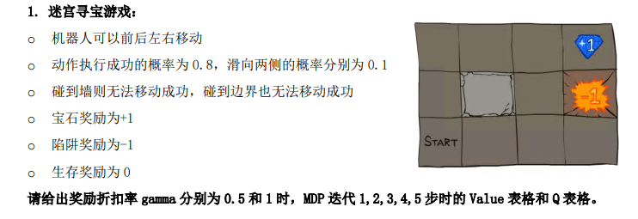
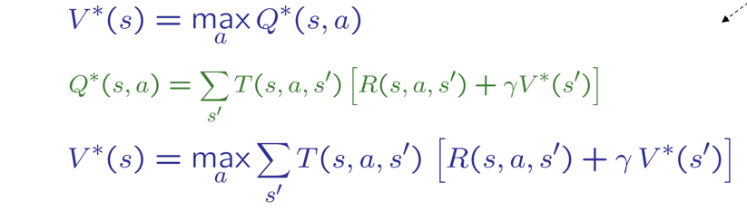
MDP问题

Slide 38
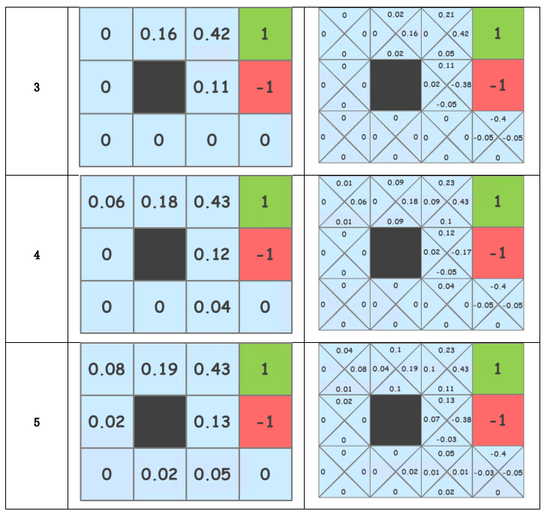
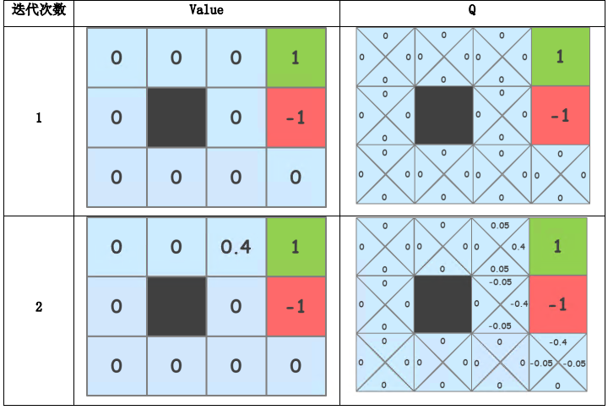
参考答案
gamma=0.5

Slide 39
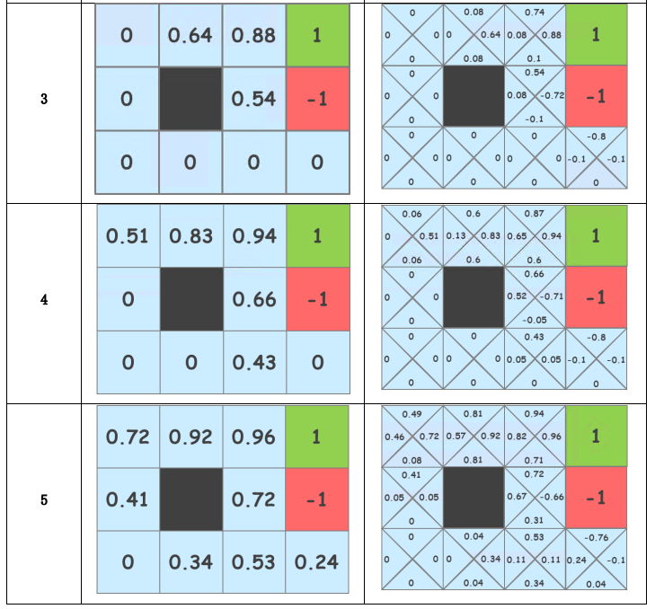
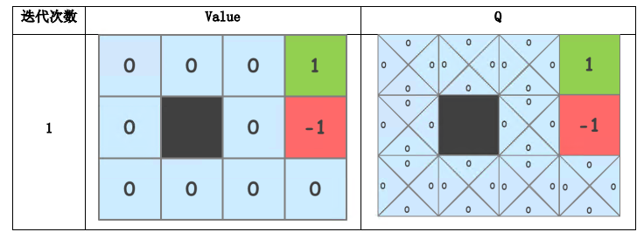
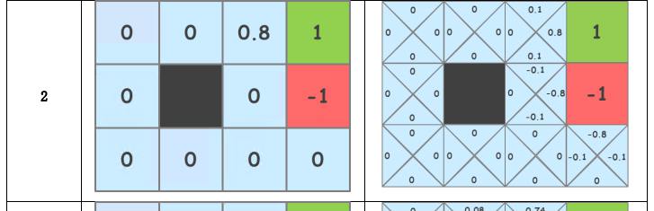
参考答案
gamma=1

Slide 40
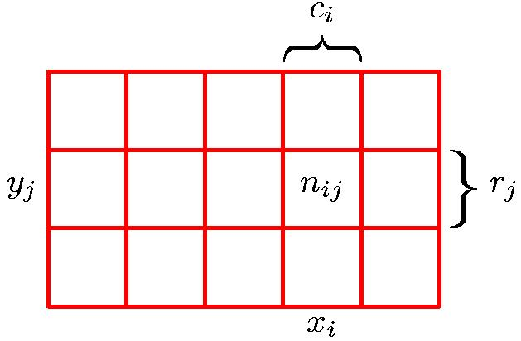
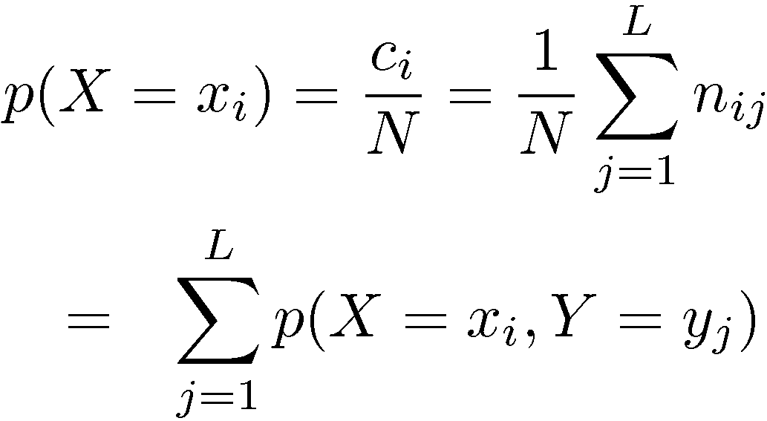
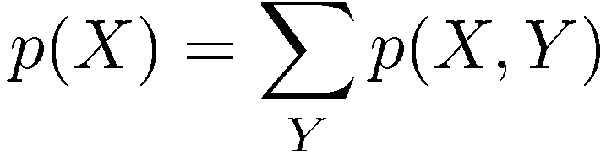
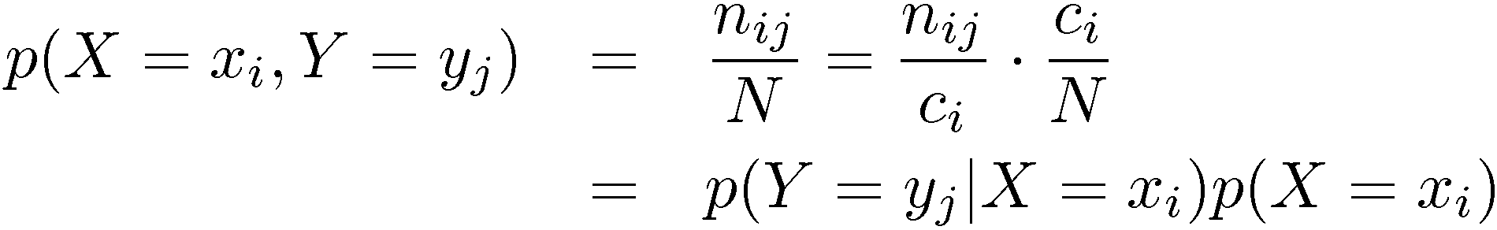
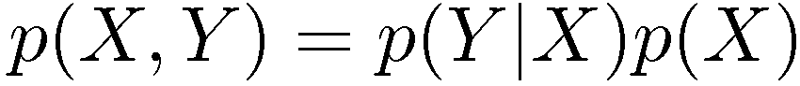
概率论法则
Y
加法法则
Sum Rule
X
乘法法则
Product Rule

Slide 41
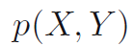
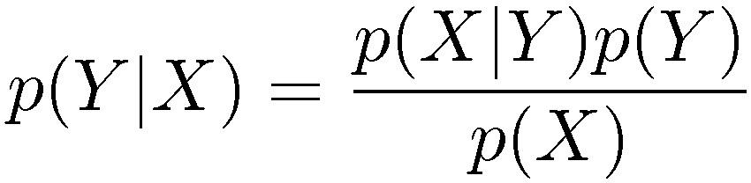
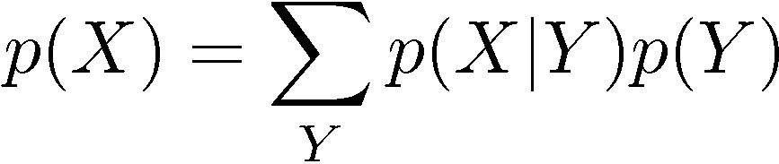
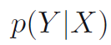
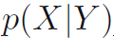
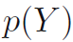
贝叶斯定理
后验
似然
先验
posterior ∝ likelihood × prior

Slide 42
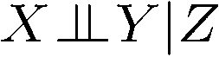
Conditional Independence
Unconditional (absolute) independence very rare (why?)
Conditional independence is our most basic and robust form of knowledge about uncertain environments.
X is conditionally independent of Y given Z
if and only if:
or, equivalently, if and only if

Slide 43

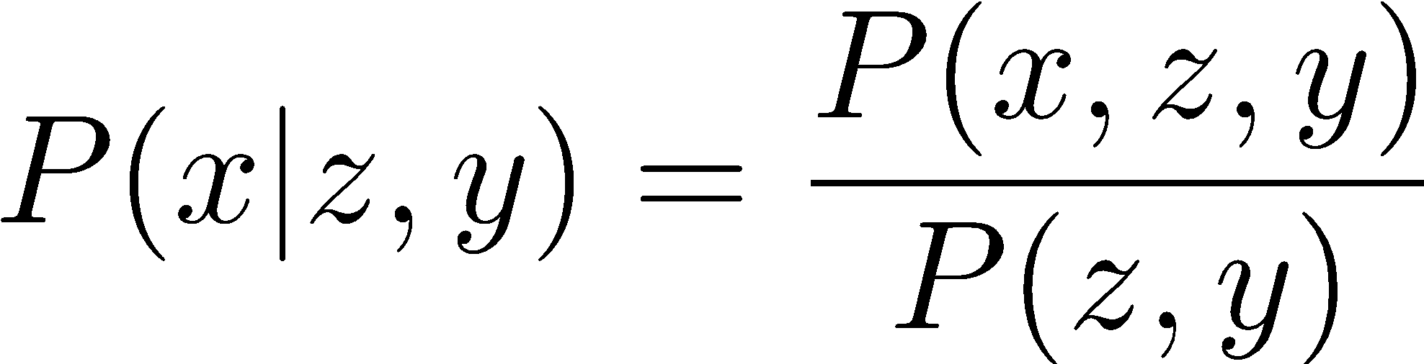
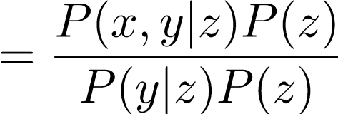
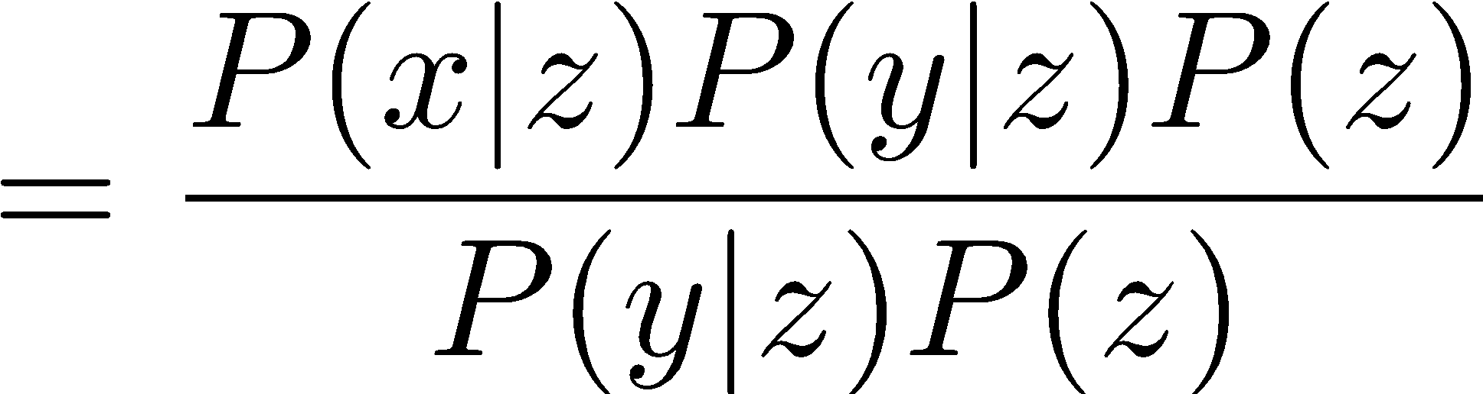
Conditional Independence
Unconditional (absolute) independence very rare (why?)
Conditional independence is our most basic and robust form of knowledge about uncertain environments.
X is conditionally independent of Y given Z
if and only if:
or, equivalently, if and only if

Slide 44
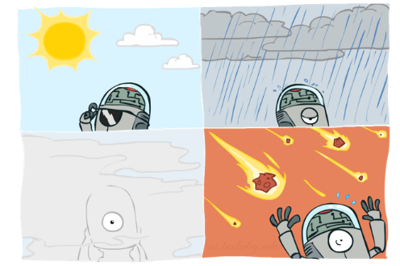
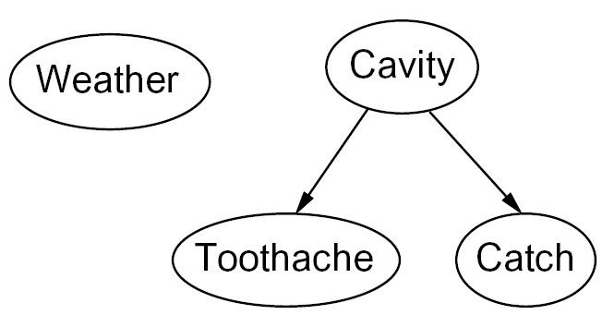

Graphical Model Notation
Nodes: variables (with domains)
Can be assigned (observed) or unassigned (unobserved)
节点：变量
可以指定（观察）或未指定（未观察）
Arcs: interactions
Indicate “direct influence” between variables
Formally: encode conditional independence
弧：交互性
指出变量之间的“直接影响”
形式上：编码条件独立性
For now: imagine that arrows mean direct causation (in general, they don’t!)
现在：想象箭头意味着直接因果关系

Slide 45
贝叶斯网络的定义
定义 设X={ X₁, X₂, …, X_{n} }是任何随机变量集，其上的贝叶斯网络可定义为BN=（B_{S}，B_{P}）。其中：
① B_{S}是贝叶斯网络的结构，即一个定义在X上的有向无环图。其中的每一个节点X_{i}都唯一地对应着X中的一个随机变量，并需要标注定量的概率信息；每条有向边都表示它所连接的两个节点之间的条件依赖关系。
② B_{p}为贝叶斯网络的条件概率集合，B_{p}={ P(X_{i} | par(X_{i})) }。其中，par(X_{i})表示X_{i}的所有父节点的相应取值，P(X_{i} | par(X_{i}))是节点X_{i}的一个条件概率分布函数。
从以上定义可以看出，贝叶斯网络中的弧是有方向的，且不能形成回路，因此图有始点和终点。

Slide 46
贝叶斯网络的条件依赖关系表示
从贝叶斯网络的局部化特征可以看出，贝叶斯网络能实现简化计算的最根本基础是条件独立性，即一个节点与它的祖先节点之间是条件独立的。下面从网络拓扑结构去定义下面两个条件独立关系的判别准则：
(1) 给定父节点，一个节点与非其后代的节点之间是条件独立的。
例如，在图5.4所示的贝叶斯网络中，给定父节点“产生焦虑”的取值（即T或F），节点“思维迟缓”与非其后代节点“碰见难题”和节点“遇到干扰”之间是条件独立的。同样，节点“情绪波动”与非其后代节点“碰见难题”和节点“遇到干扰”之间也是条件独立的。
D
P(D)
0.15
I
P(I)
0.05
碰见难题
遇到干扰
D I P(A|D,I)
T T 0.8
T F 0.4
F T 0.5
F F 0.1
A
产生焦虑
C
A P(C|A)
T 0.8
E
A P(E|A)
T 0.9
思维迟缓
情绪波动
图5.4 关于学习心理的贝叶斯网络

Slide 47
贝叶斯网络的条件依赖关系表示
(2) 给定一个节点，该节点与其父节点、子节点和子节点的父节点一起构成了一个马尔科夫覆盖，则该节点与马尔科夫覆盖以外的所有节点之间都是条件独立的。
例如，在图5.4所示的贝叶斯网络中，若给定一个节点“碰见难题”，其马尔科夫覆盖包括“产生焦虑”、“遇到干扰” 。
此时，节点“碰见难题”与处于马尔科夫覆盖以外的那些节点，如节点“思维迟缓”和节点“情绪波动”之间都是条件独立的。
D
P(D)
0.15
I
P(I)
0.05
碰见难题
遇到干扰
D I P(A|D,I)
T T 0.8
T F 0.4
F T 0.5
F F 0.1
A
产生焦虑
C
A P(C|A)
T 0.8
E
A P(E|A)
T 0.9
思维迟缓
情绪波动
图5.4 关于学习心理的贝叶斯网络

Slide 48
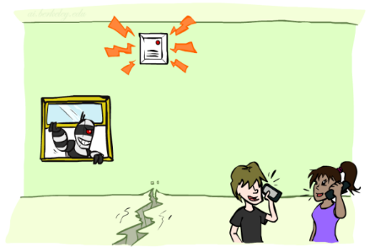
Example: Alarm Network
B | P(B)
+b | 0.001
-b | 0.999
E | P(E)
+e | 0.002
-e | 0.998
Burglary
Earthqk
Alarm
B | E | A | P(A|B,E)
+b | +e | +a | 0.95
+b | +e | -a | 0.05
+b | -e | +a | 0.94
+b | -e | -a | 0.06
-b | +e | +a | 0.29
-b | +e | -a | 0.71
-b | -e | +a | 0.001
-b | -e | -a | 0.999
John calls
Mary calls
A | J | P(J|A)
+a | +j | 0.9
+a | -j | 0.1
-a | +j | 0.05
-a | -j | 0.95
A | M | P(M|A)
+a | +m | 0.7
+a | -m | 0.3
-a | +m | 0.01
-a | -m | 0.99
Notes:
Demo:
Draw network
Specify the CPTs
Then query, e.g., Mary Calls --- not something we specified, inference computed this for us
P(B) = ?
P(B | +e) = ?
Independence
P(B) = ?
P(B | +m) = ?
Show explaining away

Slide 49
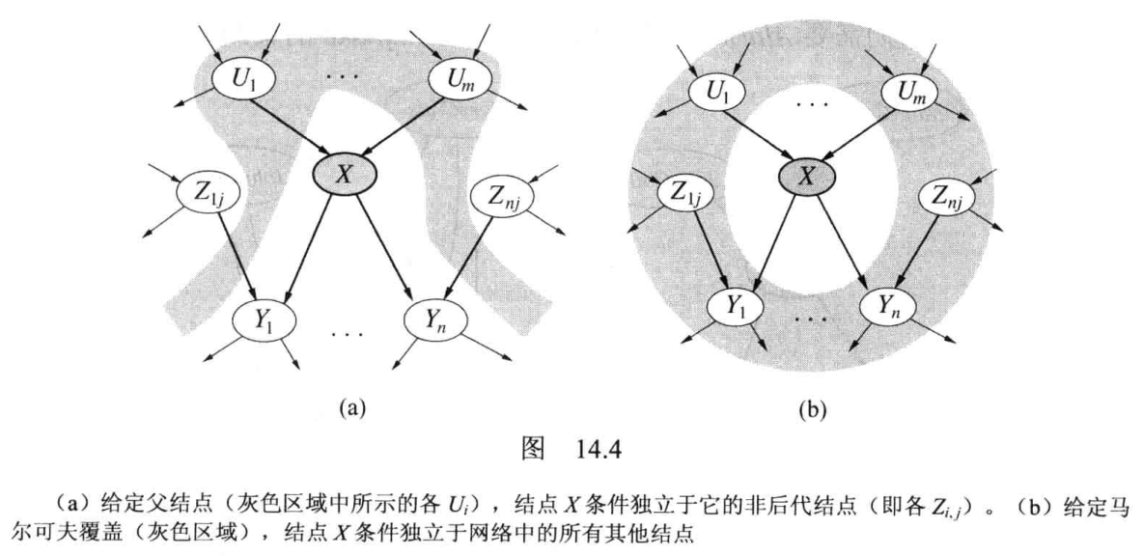
局部马尔可夫性质

Slide 50
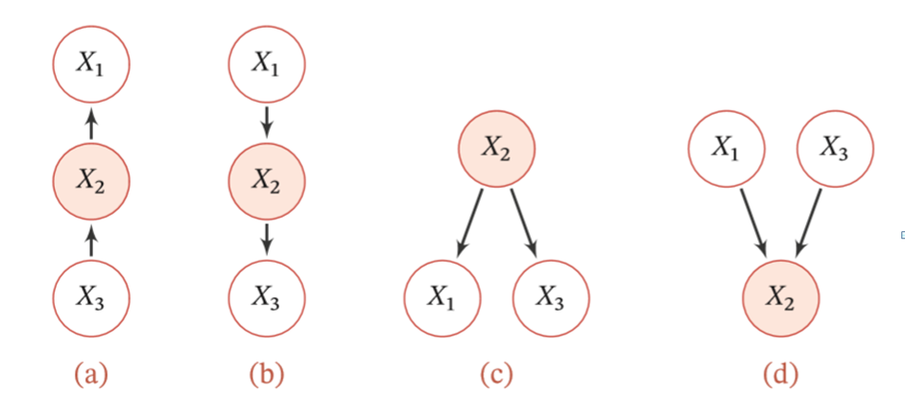
三个变量的依赖关系示例
（1） 间接因果关系（a）：当 𝑋2 已知时，𝑋1 和 𝑋3 为条件独立。
（2） 间接果因关系（b）：当 𝑋2 已知时，𝑋1 和 𝑋3 为条件独立。
（3） 共因关系（c）：当 𝑋2 未知时，𝑋1 和 𝑋3 是不独立的；
当 𝑋2 已知 时，𝑋1 和 𝑋3 条件独立。
（4） 共果关系（d）：当𝑋2 未知时，𝑋1 和 𝑋3 是独立的；
当𝑋2 已知时， 𝑋1 和 𝑋3 不独立。

Slide 51
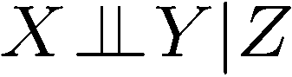
条件独立
(Conditional) independence is a property of a distribution
朴素贝叶斯分类需要用数学描述，如Class是某个类别集合，可以表示为Class={类别1，类别2，类别3，，，类别n}，待分类某个样本特征集合={特征1，特征2，特征3，，，特征n}。

Slide 52
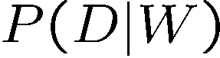


作业1: 贝叶斯规则
D | W | P
wet | sun | 0.1
dry | sun | 0.9
wet | rain | 0.7
dry | rain | 0.3
Given:
What is P(W | dry) ?
R | P
sun | 0.8
rain | 0.2

Slide 53
作业2: 朴素贝叶斯
某家医院上午来了10个病人，其信息如下表，现在来了一位咳嗽的学生，请用朴素贝叶斯方法计算他患上新冠的概率有多大。
症状 | 职业 | 疾病
咳嗽 | 程序员 | 感冒
发烧 | 程序员 | 新冠
咳嗽 | 学生 | 感冒
发烧 | 教师 | 感冒
咳嗽 | 学生 | 感冒
发烧 | 学生 | 新冠
咳嗽 | 教师 | 感冒
咳嗽 | 学生 | 新冠
咳嗽 | 学生 | 感冒
发烧 | 程序员 | 新冠

Slide 54
症状 | 职业 | 疾病
咳嗽 | 程序员 | 感冒
发烧 | 程序员 | 新冠
咳嗽 | 学生 | 感冒
发烧 | 教师 | 感冒
咳嗽 | 学生 | 感冒
发烧 | 学生 | 新冠
咳嗽 | 教师 | 感冒
咳嗽 | 学生 | 新冠
咳嗽 | 学生 | 感冒
发烧 | 程序员 | 新冠

Slide 55
作业3:贝叶斯网络
假设：S(Smoker)： 该患者为吸烟者；
C(Coal miner)：该患者是煤矿工人;
L(Lung cancer)：他患了肺癌；
E(Emphysema)：他患了肺气肿
先验结构：S 可能导致 L 和 E，C 可能导致 E。
1）构造贝叶斯网络
2）给定S，计算P(E|S)
已知： P(S)= 0.4，P(C)= 0.3，P(E|S, C)= 0.9，P(E|S, ～C)= 0.3
P(E|～S, C)=0.5，P(E|～S, ～C)=0.1

Slide 56
已知父节点计算子节点
P(E|S) = P(E,C|S) + P(E,~C|S) 全概率
P(E,C|S) = P(E,C,S)/P(S) 联合概率
= P(E|C,S)*P(C,S)/P(S) 联合概率
= P(E|C,S)*P(C|S) 联合概率
= P(E|C,S)*P(C) 独立
P(E,~C|S) = P(E|~C,S)*P(~C)
S
C
L
E
P(E|S) =P(E|C,S)*P(C) + P(E|~C,S)* P(~C)
=0.9*0.3+0.3*(1-0.3)
=0.48
已知： P(S)= 0.4，P(C)= 0.3，P(E|S, C)= 0.9，P(E|S, ～C)= 0.3
P(E|～S, C)=0.5，P(E|～S, ～C)=0.1

Slide 57

S
C
L
E
已知： P(S)= 0.4，P(C)= 0.3，
P(E|S, C)= 0.9，P(E|S, ～C)= 0.3
P(E|～S, C)=0.5，P(E|～S, ～C)=0.1

Slide 58



监督学习Supervised Learning
监督学习
从标记的训练数据集学习一个模型，再用此模型对测试样本集进行预测。
典型应用
回归
分类

Slide 59

Choosing an attribute: Information gain
Idea: measure contribution of attribute to increasing “purity” of labels in each subset of examples; find most distinguishing feature
Patrons is a better choice: gives information about classification; more distinguishing feature

Slide 60
Information
Information answers questions
The more clueless I am about the answer initially, the more information is contained in the answer
Scale: 1 bit = answer to Boolean question with prior ⟨0.5, 0.5⟩
= -plog p -(1-p)log (1-p)= –0.5log0.5-(1-0.5)log (1-0.5)=1
For a coin with probability p=0.2 heads, entropy(熵) H( ⟨p,1-p⟩) = -plog p -(1-p)log (1-p)= -0.2log0.2 -(1-0.2)log (1-0.2)=0.729 熵变小了，不确定性变小了
Convenient notation: B(p) = H(⟨p,1-p⟩)

Slide 61


Information gain from splitting on an attribute
Suppose we have p positive and n negative examples at the root
=> B(p/(p+n)) bits needed to classify a new example
E.g., for 12 restaurant examples, p = n = 6 so we need 1 bit
An attribute splits the examples E into subsets E_{k}, each of which (we hope) needs less information to complete the classification
For an example in E_{k} we expect to need B(p_{k}/(p_{k}+n_{k})) more bits
Probability a new example goes into E_{k} is
Expected number of bits needed after split is
Information gain = B(p/(p+n)) - Σ_{k} (p_{k}+n_{k})/(p+n) B(p_{k}/(p_{k}+n_{k}))
(p_{k}+n_{k})/(p+n)
Σ_{k} (p_{k}+n_{k})/(p+n) B(p_{k}/(p_{k}+n_{k}))

Slide 62
Example
Information gain? 信息增益
Information gain = B(p/(p+n)) - Σ_{k} (p_{k}+n_{k})/(p+n)B(p_{k}/(p_{k}+n_{k}))

Slide 63
Example
1 – [(2/12)B(0) + (4/12)B(1) + (6/12)B(2/6)]
= 0.541 bits
1 – [(2/12)B(1/2) + (2/12)B(1/2) +
(4/12)B(2/4) + (4/12)B(2/4)]
= 0 bits

Slide 64

Results for restaurant data
Decision tree learned from the 12 examples:
Simpler than “true” tree!

Slide 65

作 业
1. 基于以下数据，通过计算Information gain，做出决策树。

Slide 66

D中有两个类，正例p1=3/6, 反例p2=3/6
Ent(D)=-p1*log(p1)-p2*log(p2)
=-3/6*log(3/6)-3/6*log(3/6)=1。
属性A有两个值,
D1(A=T)包含编号为{1，2，3}，正例p1=2/3,反例p2=1/3
D2(A=F)包含编号为{4，5，6}，正例p1=1/3,反例p2=2/3。
Ent(D1)=-2/3*log(2/3)-1/3*log(1/3)=0.918
Ent(D2)=-1/3*log(1/3)-2/3*log(2/3)=0.918
Gain(D,A)=Ent(D)-3/6*Ent(D1)- 3/6*Ent(D2)=1-0.918=0.082

Slide 67
D中有两个类，正例p1=3/6, 反例p2=3/6
Ent(D)=-p1*log(p1)-p2*log(p2)
=-3/6*log(3/6)-3/6*log(3/6)=1。
属性B有两个值,
D1(B=T)包含编号为{1，2，5, 6}，正例p1=2/4,反例p2=2/4
D2(B=F)包含编号为{3，4}，正例p1=1/2,反例p2=1/2
Ent(D1)=-2/4*log(2/4)-2/4*log(2/4)=1
Ent(D2)=-1/2*log(1/2)-1/2*log(1/2)=1
Gain(D,B)=Ent(D)-4/6*Ent(D1)- 2/6*Ent(D2)=0
显然，属性A的信息增益较大，于是它被选为划分属性。

Slide 68




A few important points about learning
Data: labeled instances, e.g. emails marked spam/ham
Training set（训练集）
Held out set（验证集）
Test set（测试集）
Features: attribute-value pairs which characterize each x
Experimentation cycle
Learn parameters on training set
(Tune hyperparameters on held-out set)
Compute accuracy of test set
Very important: never “peek”(“偷看”) at the test set!
Evaluation
Accuracy: fraction of instances predicted correctly
Overfitting and generalization
Want a classifier which does well on test data
Overfitting: fitting the training data very closely, but not generalizing well
Underfitting: fits the training set poorly
Training
Data
Held-Out
Data
(Validation set)
Test
Data

Slide 69
Linear regression = fitting a straight line/hyperplane
40
h_{w}(x)
20
0
0
x
20
Prediction: h_{w}(x) = w₀ + w₁x
Berkeley house prices, 2009
Notes:
Figure 1: scatter(1:20,10+(1:20)+2*randn(1,20),'k','filled'); a=axis; a(3)=0; axis(a);

Slide 70
Least squares: Minimizing squared error
L2 loss function: sum of squared errors over all examples
Loss = Σ_{j} (y_{j} – h_{w}(x_{j}))² = Σ_{j} (y_{j} – (w₀ + w₁x_{j}))²
We want the weights w* that minimize loss
At w* the derivatives of loss w.r.t. each weight are zero:
∂Loss/∂w₀ = – 2 Σ_{j} (y_{j} – (w₀ + w₁x_{j})) = 0
∂Loss/∂w₁ = – 2 Σ_{j} (y_{j} – (w₀ + w₁x_{j})) x_{j} = 0
Exact solutions for N examples:
w₁ = [NΣ_{j} x_{j}y_{j} – (Σ_{j} x_{j})(Σ_{j} y_{j})]/[NΣ_{j} x_{j}² – (Σ_{j} x_{j})²] and w₀ = 1/N [Σ_{j} y_{j} – w₁Σ_{j} x_{j}]

Slide 71
作 业
2.有如下表的训练数据，x为输入，y为输出，试求解这个回归问题。
（1）用函数形式 y=wx 来拟合，利用L2 loss求w；
（2）用函数形式 y=wx^2 来拟合，利用L2 loss求w。
x | 1 | 0 | 2
y | 0.9 | 0.1 | 2.2

Slide 72
（1）用函数形式 y=wx 来拟合，利用L2 loss求w；
优化目标为：L=(1.8-1.5w)^2+(0.1-0)^2+(0.9-w)^2+(2.2-2w)^2
L对w的导数为：-3(1.8-1.5w)-2(0.9-w)-4(2.2-2w)=14.5w-16
令其为0可得：w=1.103
（2）用函数形式 y=wx^2 来拟合，利用L2 loss求w。
优化目标为：L=(1.8-2.25w)^2+(0.1-0)^2+(0.9-w)^2+(2.2-4w)^2
L对w的导数为：-4.5(1.8-2.25w)-2(0.9-w)-8(2.2-2w)=28.125w-27.5
令其为0可得：w=0.978

Slide 73
作 业
3. 考虑一个支持向量机和下面来自两类的训练样本
+1: (1, 2) (2, 3) (3, 3)
-1: (2, 1) (3, 2)
(1) 在图上标出这5个点，通过观察画出最优分类面，给出分类面的方程w1x1+w2x2+b=0。计算出它的间隔margin（从分类面到最近数据点的距离的两倍）。
(2)写出所有的支持向量。

Slide 74

+1: (1, 2) (2, 3) (3, 3)
-1: (2, 1) (3, 2)
方程：x1 – x2 = 0
Margin：sqrt(2)
(2)写出所有的支持向量？
支持向量是(1,2), (2,3), (2,1), (3, 2)

Slide 75
关于考试
正误判断（16题，2分/题，共32分）
单选题（ 8题，3分/题，共24分）
综合题（1题6分，2题8分，
3、4、5题 10分/题，共44分）

Slide 76
考核方式
平时成绩(20%)+实验成绩（30%)+期末成绩(闭卷笔试50%)
期末考试时间：
第17周周二（12月21日）晚19:00-21:00

